Slide 1
Virtual Roll Call
Frank Vincench – Developer
Peter Reidy – Developer
Major Jason Cohen – Product Owner
Masoud Sadjadi – Instructor

Slide 2
Problem Definition
Current System
Physical Meeting in the morning where officers are presented information by a supervisor.
Officers may not be able to attend due to many factors like an overlapping assignment, a court date, and high call volume.
Officers who miss the meeting are deprived of information and must receive it through second hand sources.
Notes:
How presentation will benefit audience: Adult learners are more interested in a subject if they know how or why it is important to them.
Presenter’s level of expertise in the subject: Briefly state your credentials in this area, or explain why participants should listen to you.

Slide 3
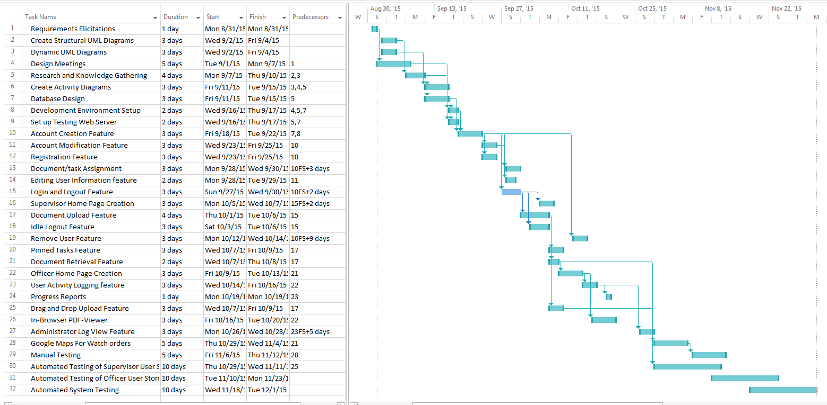
Project Management (Gantt Chart)
Lesson 1: Name
Notes:
Lesson descriptions should be brief.

Slide 4
Requirements
Notes:
Example objectives
At the end of this lesson, you will be able to:
Save files to the team Web server.
Move files to different locations on the team Web server.
Share files on the team Web server.

Slide 5
User Stories Implemented
Implemented User Stories
Login/Logout – Allows users to login to an appropriate account showing proper permissions and abilities of the user
Account Creation – As an administrator, a user can create new accounts within the system.
Tabbed View – As an officer, a user can view uploaded files according to the category.
Task History – As an officer, a user can view uploaded files from previous days in case of missed work.
Pinning Tasks – As a supervisor, a user can pin a task so that it is moved to the top of an officer’s view and doesn’t get archived.
Task Assignment – As a supervisor, a user can distribute documents or tasks to officers based on their shifts.
Category Creation – As an administrator, a user can create a new category that will appear in a different view for officers.

Slide 6
User Stories Implemented (contd.)
Implemented User Stories
Preview Task Assignment – As a supervisor, a user can see the tasks that he has assigned to which shift.
Account Modification – As an administrator, a user can edit the information of any user.
User Monitoring – As an administrator, a user can monitor the activity of other users within the website.

Slide 7
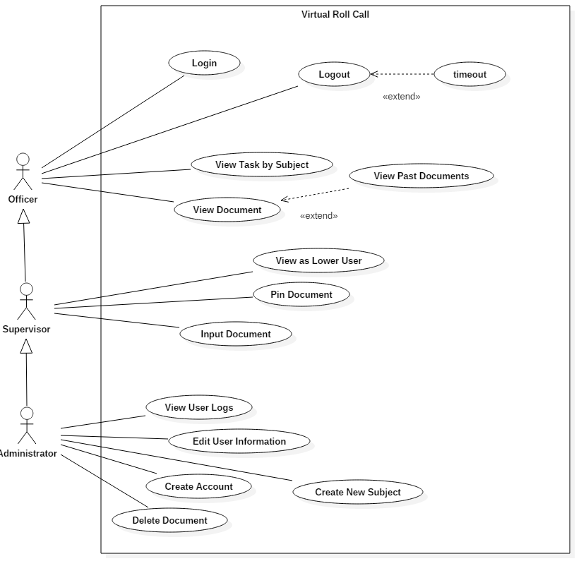
Use Case Diagram
All Use Cases

Slide 8
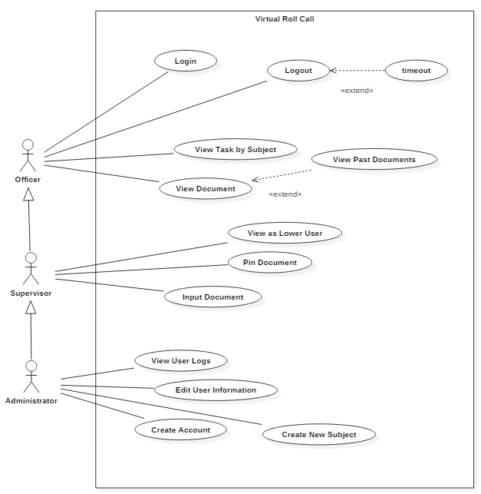
Implemented Use Cases
Implemented Use Cases

Slide 9
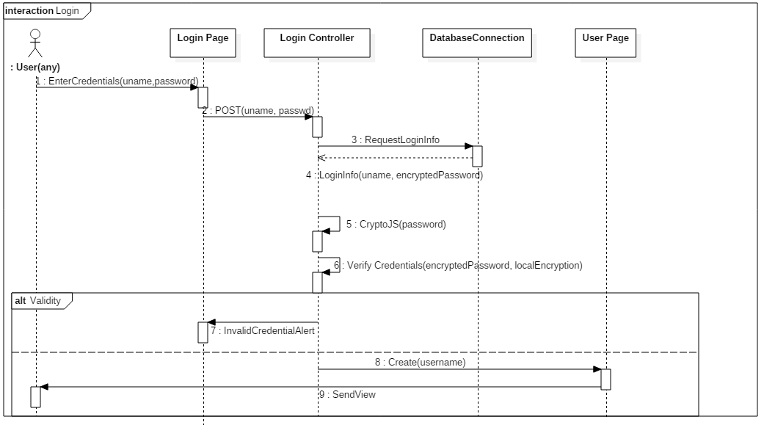
Sequence Diagram (Login)

Slide 10
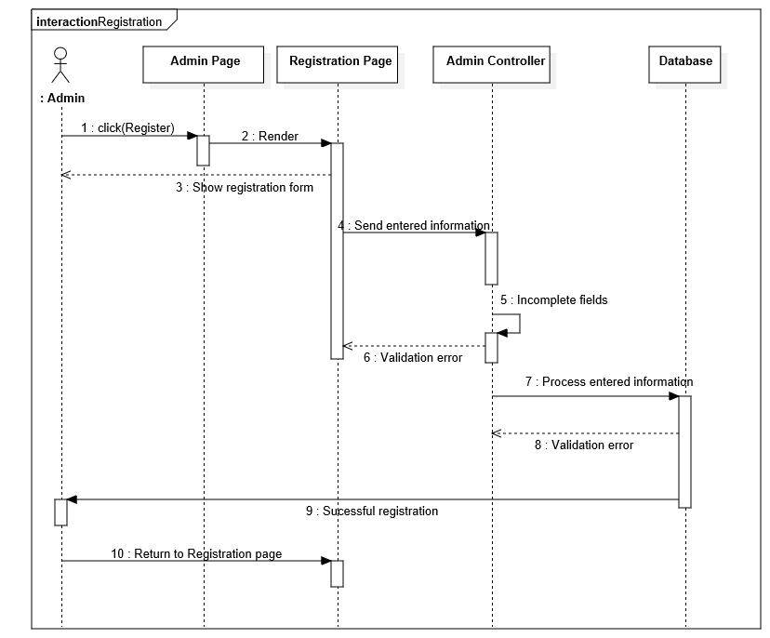
Sequence Diagram (Registration)

Slide 11
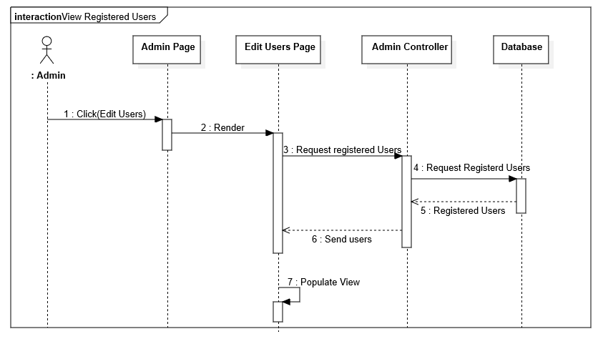
Sequence Diagram (View Registered Users)

Slide 12
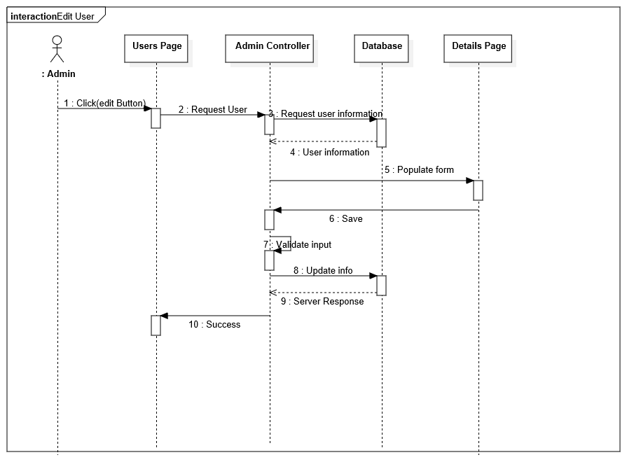
Sequence Diagram (Edit User Info)

Slide 13
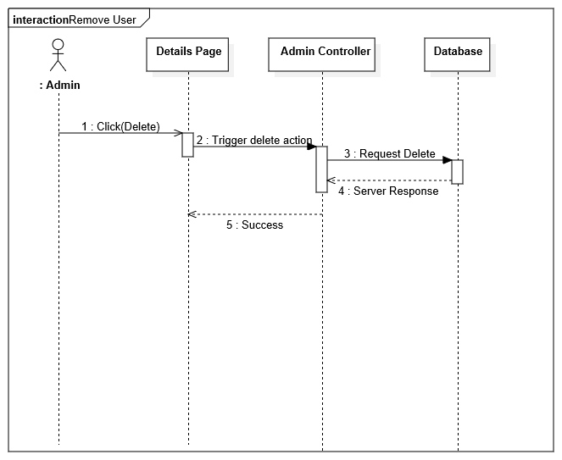
Sequence Diagram (Delete User)

Slide 14
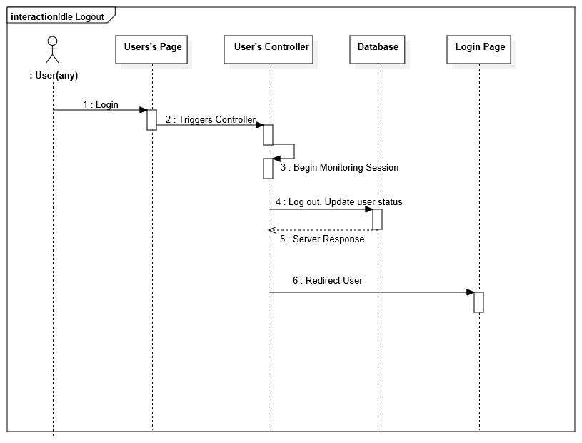
Sequence Diagram (Idle Logout)

Slide 15
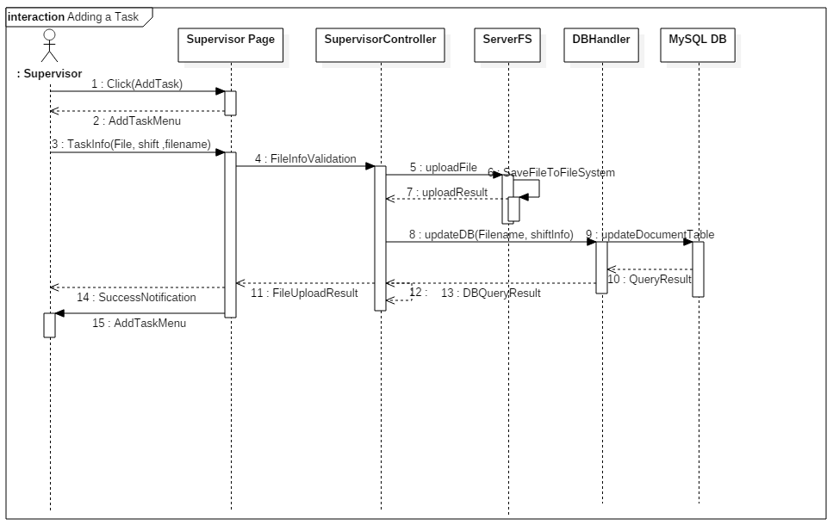
Sequence Diagram (Add Document)

Slide 16
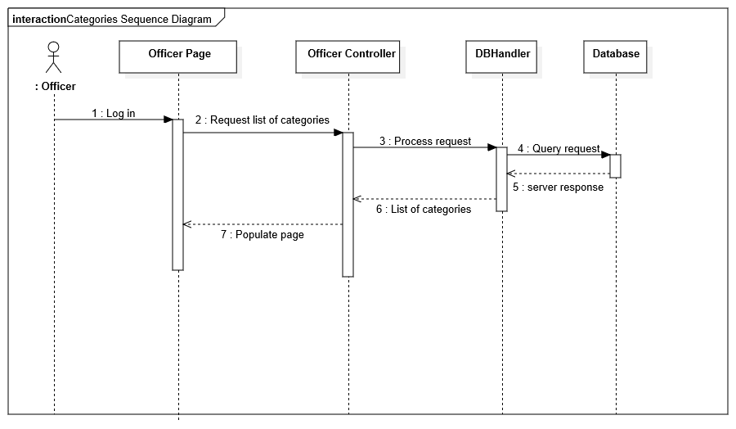
Sequence Diagram (Get Categories)

Slide 17
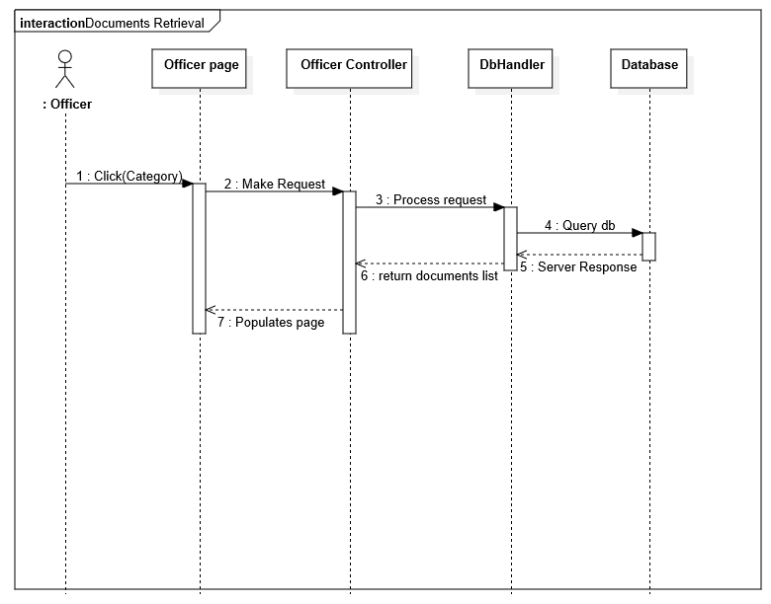
Sequence Diagram (Document Retrieval)

Slide 18
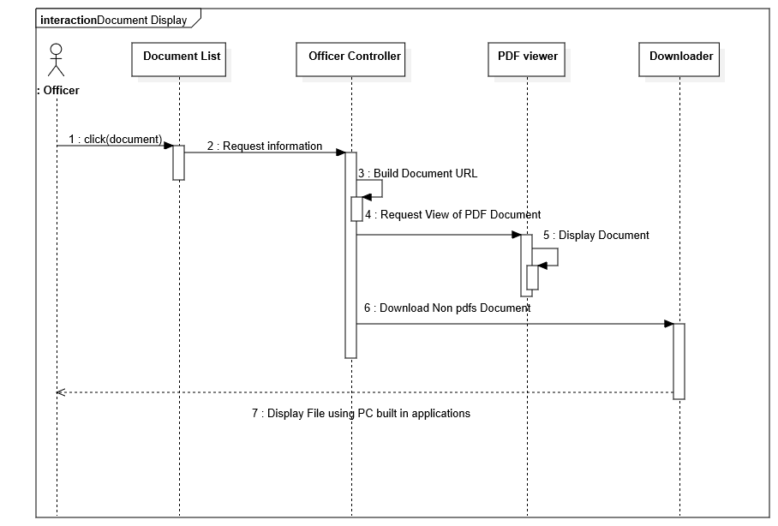
Sequence Diagram (Display Document)

Slide 19
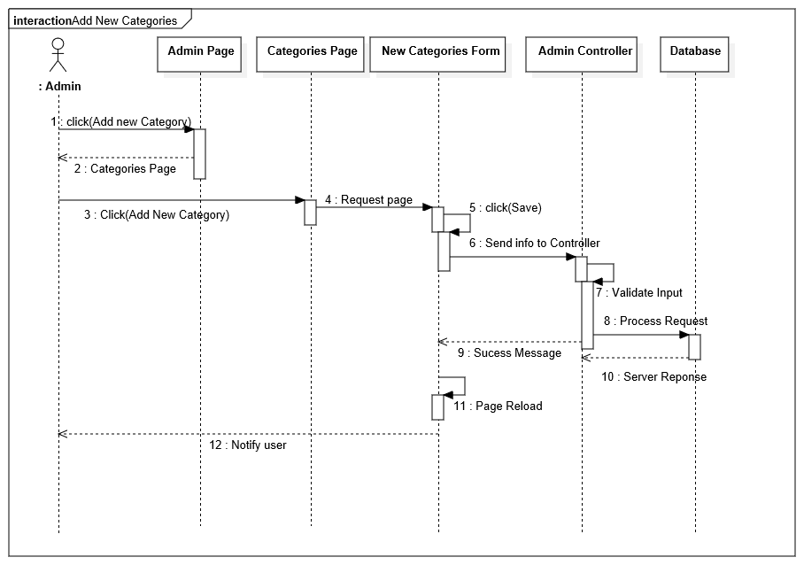
Sequence Diagram (Create New Category)

Slide 20
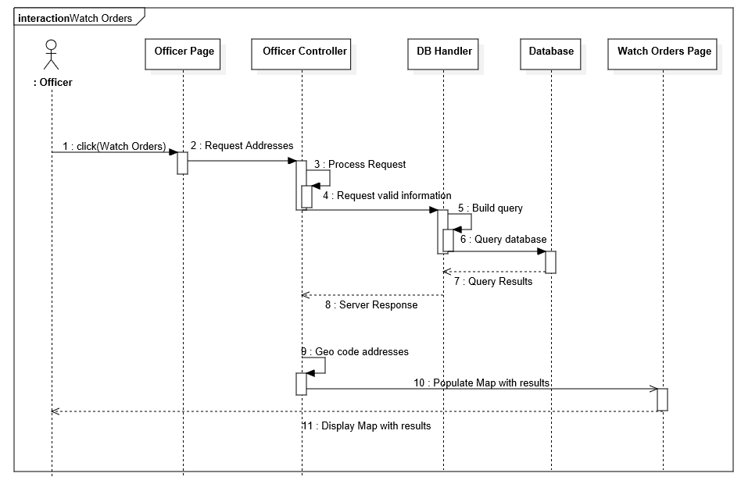
Sequence Diagram (Watch Order)

Slide 21
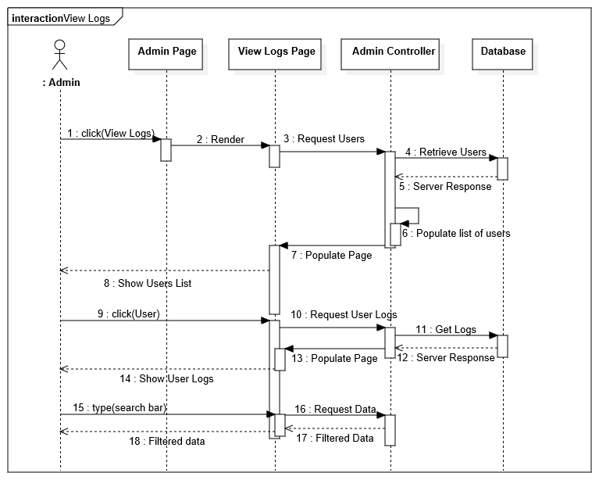
Sequence Diagram (View Logs)

Slide 22
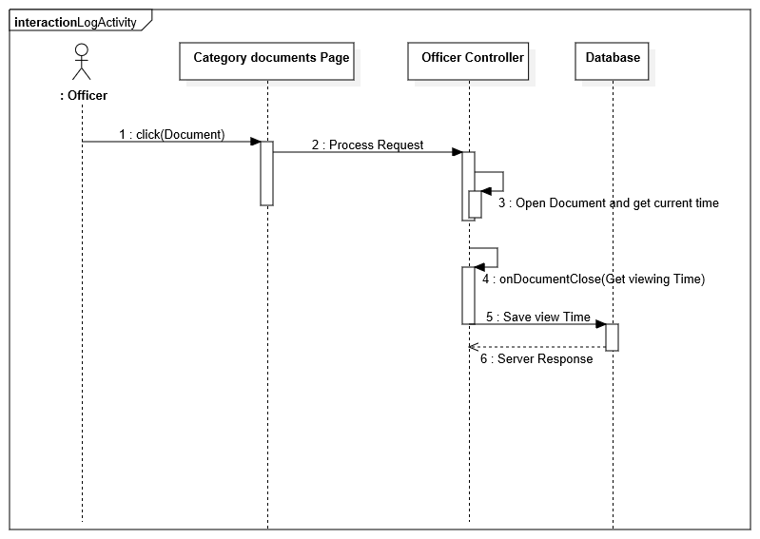
Sequence Diagram (Log Activity)

Slide 23
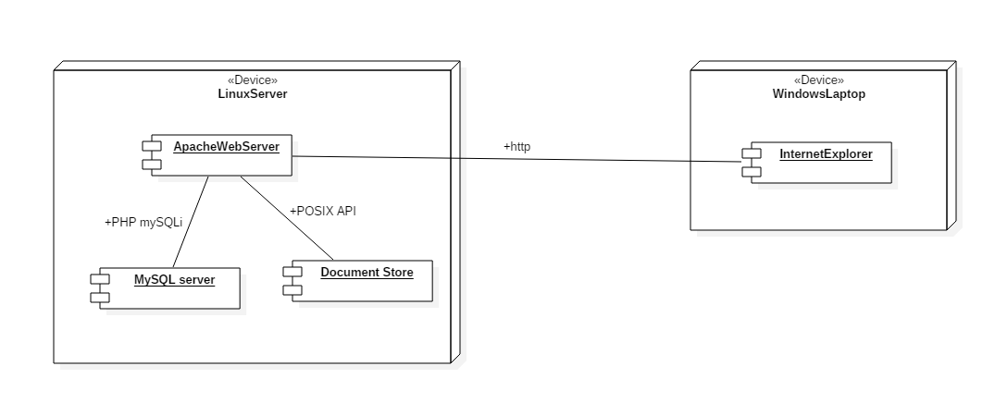
System Decomposition
Three major patterns, were used in the architecture of this program, the main one being Model-View-Controller.
The second major pattern applied to the project was a publish-subscribe pattern, where the officers are subscribed to the data publishing stream of a shift.
The third and last Design pattern used is the Factory Pattern, it is built into the angular framework, the factories are used to instantiate controllers with the proper data and functions.

Slide 24
System Deployment
Minimum Hardware Requirements
2GB RAM, 100MB extra hard drive space, 1.5 gHz CPU
Software Requirements
Apache2 http server
Ubuntu 14.04LTS
MySQL server
PHP 5.5

Slide 25
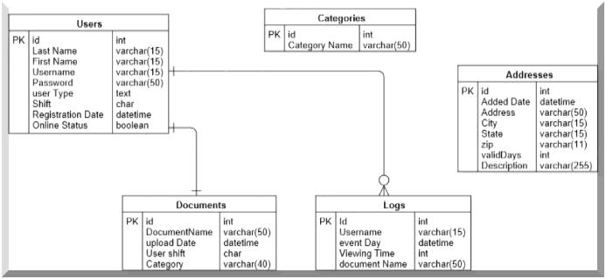
Persistent Data Design

Slide 26
Security and Privacy
Important user information is Both Salted/Hashed and Encrypted using the CryptoJS javascript library.
Deployment of Web Application planned for deployment on VPN, so there is a reliance on the added security and integrity of the VPN.

Slide 27
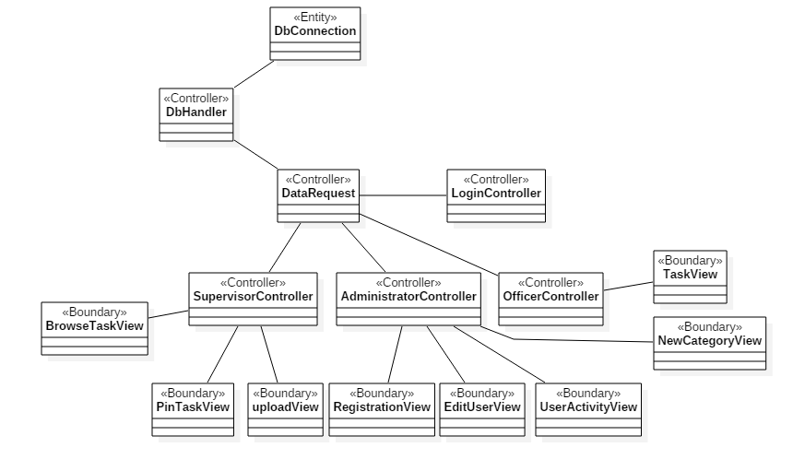
Minimal Class Diagram
We Used an MVC pattern where each user level controller has a set of associated views and updates them with information from the database.
The database is accessed through a singleton class instance called DbHandler, it helps prevent overwhelming of the database with too many requests.

Slide 28
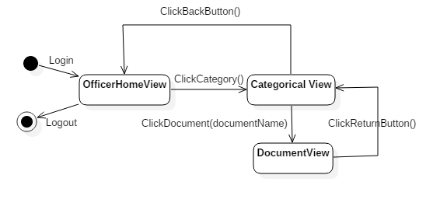
Main Algorithm, State Chart.
Most Important Feature, Viewing of PDF’s or videos.
Actions included in viewing the pdf
User is Logged in
List of categories generated using table of categories that are stored in Database.
List is used to construct Folder views containing Document Links, filtered by shift and upload dates.
Selected Documents are loaded into a pdf viewer.
Modal PDF viewer displays document.
User activity is logged when a document is selected.

Slide 29
Validation
ID | Test ID 9
Purpose | Ensure the dynamic generation of the categories are unique. Sunny.
Set up | Logged into an Administrator account.
Test Data | The default categories that come with VRC, New Category = “Squad Cars Availability”.
Expected Result | When viewing as an officer, New category titled “Squad Cars availability” is available.
ID | Test ID 11
Purpose | Ensure tasks are only visible by the correct shift. Rainy
Set up | Logged in as officer in shift C. sample.pdf uploaded to shift B.
Test Data | Sample.pdf
Expected Result | Document is not viewable when supervisor assigns it to a different shift.

Slide 30
Validation Script (PHPUnit and Selenium WebDriver)
<?php class TabbedViewTests extends PHPUnit_Framework_TestCase { protected $webDriver; protected $url = 'http://vrc-dev.cis.fiu.edu'; public function setUp(){ $capabilities= array(\Facebook\WebDriver\Remote\WebDriverCapabilityType::BROWSER_NAME => 'internet explorer'); $this->webDriver = \Facebook\WebDriver\Remote\RemoteWebDriver::create('http://localhost:4444/wd/hub',$capabilities); } public function testShiftView(){ $fileName = 'sample.pdf'; $this->webDriver->get($this->url); $this->login('Peter','peter'); $res = $this->webDriver->findElement(\Facebook\WebDriver\WebDriverBy::xpath('//div[contains(text(), "' + $fileName + '")]')); assertNull($res); } public function tearDown(){ $this->webDriver->quit(); } public function login($uname,$pass){ $this->webDriver->get($this->url); $usernameBox = $this->webDriver->findElement(\Facebook\WebDriver\WebDriverBy::id("username")); $passwordInput = $this->webDriver->findElement(\Facebook\WebDriver\WebDriverBy::id("password")); $usernameBox->click(); $this->webDriver->getKeyboard()->sendKeys($uname); $this->webDriver->wait(1); $passwordInput->click(); $this->webDriver->getKeyboard()->sendKeys($pass); $submit = $this->webDriver->findElement(\Facebook\WebDriver\WebDriverBy::id('submit')); $submit->click(); }

Slide 31
Demonstration Of Software
User Activity Use Case
Task Assignment Use Case
Task Viewing Use Case
Register User Use Case
Enjoy! ☺

